Slide 1
Tensor Flow fundamentals for Deep Learning
ANNs (Artificial Neural Network)
TF Playground
Load TF and Data
Model Training
Model Evaluation
Implementation using Single Neuron
Shahzaib Hamid
AI Sciences Instructor

Slide 2
Module Overview
ANNs
TF Playground
Load TF and Data
Model Training
Model Evaluation
Implementation using Single Neuron
Definition
Working
Definition
Features
Installation
Libraries
Steps
Definition
Steps
Definition
Steps
Project
Formula
Example
Objectives

Slide 3

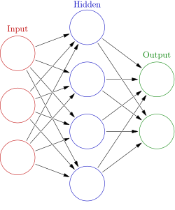
(Artificial Neural Networks)ANNs
A Neural network (Artificial Neuron Network) is a computational model that simulates the function of nerve cells within the human brain.

Slide 4

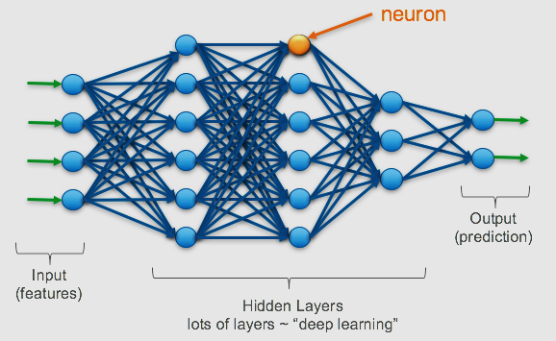
(Artificial Neural Networks)ANNs
Example

Slide 5

(Artificial Neural Networks)ANNs
How ANNs Works?
The brain contains over 100 billion neurons that communicate via electric and chemical signals.
01
Neurons communicate with one another and assist us in seeing, thinking, and generating ideas.
02
03
The human brain learns by connecting these Neurons.
ANNs are Human Brain-Inspired Information Processing Models.
04

Slide 6
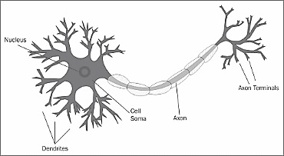

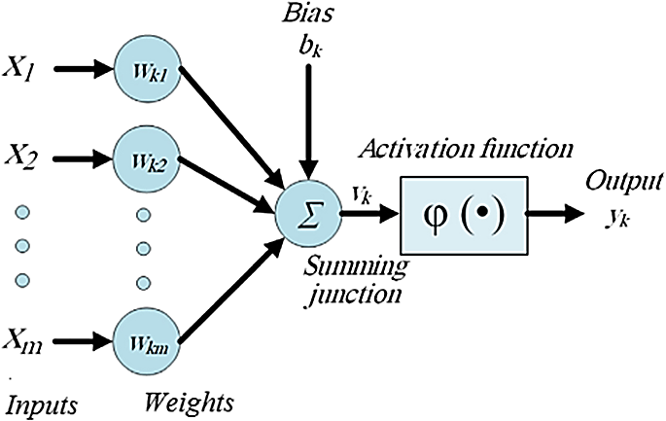
(Artificial Neural Networks)ANNs
Biological Neuron Model
Artificial Neuron Model

Slide 7
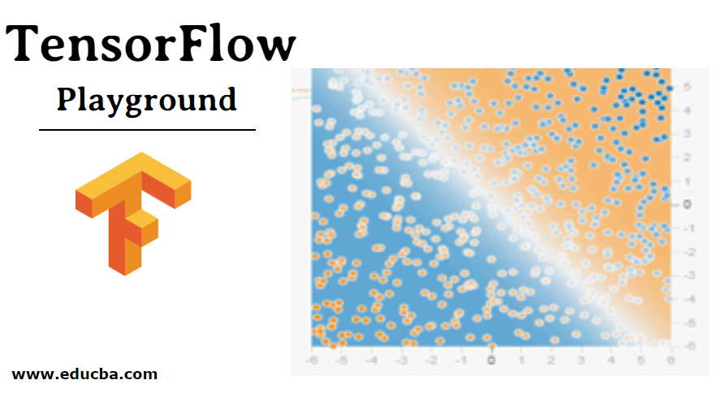
Tensor Flow Playground
Tensor Flow Playground is a web app that allows users to test AI algorithms using the Tensor Flow machine learning library.

Slide 8

Tensor Flow Playground
Hidden Layers
Data
There are Some Features of TF Playground:
Epoch
Learning
Rate
Activation Function
More
Features

Slide 9

Load TF and Data
Firstly Install Tensor flow 2.0
!pip install tensorflow
There are Some Steps to Load TF and Data
Import Libraries & Import Data

Slide 10
Load TF and Data
Import Data
Specify the Name of Variable
Use Pandas Library with Read Function
Enter the Type of File
Enter the Exact Name of File/Address
Press Enter

Slide 11


Load TF and Data
Example

Slide 12

Model Training
Model training is the process of optimizing the weights and biases of a neural network to minimize the difference between its predicted outputs and the actual outputs from the training data.
Model Training

Slide 13
Model Training
There are Some Steps to Train a Model:
Data is being added to the model in batches.
Querying the model for a prediction.
Using that prediction, compare it to the "true" value.
Choosing how much each parameter should be changed.

Slide 14
Model Evaluation
Evaluating model is used to evaluate an already trained model using validation (or test) data and labels.
Model Evaluation

Slide 15
Model Evaluation
There are Some Steps to Evaluate a Model:
There are numerous built-in optimizers, losses, and metrics.
Customs penalties.
Metrics that are unique to you.
Dealing with losses and metrics that do not fit the standard signature
Setting up a validation holdout set automatically.

Slide 16
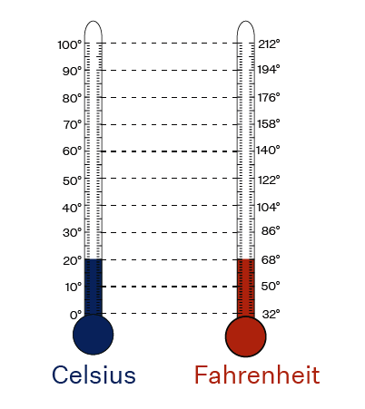
Project implementation code

Slide 17

Project: Implementation using Single Neuron
Simple machine learning model to convert temperature from Celsius to Fahrenheit in this project.

Slide 18
Project: Implementation using Single Neuron
Formula:
T(°F) = T(°C)*9/5+32

Slide 19

Project: Implementation using single Neuron
There are Some Objectives:
Forecasting the value of one variable Y using the value of another variable X.
X is the unbiased variable, and Y is the based variable.
Regression will be discussed in greater depth in a later section of the course.

Slide 20
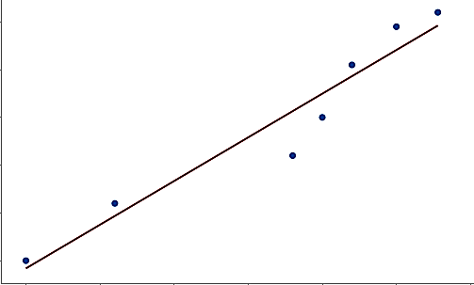
Project: Implementation using single Neuron
Graph
Temp. in Fahrenheit (°F)
Temp. in Celsius (°C)

